Slide 1
New Student Organization request
Presentation
Preparation
Guide

Slide 2
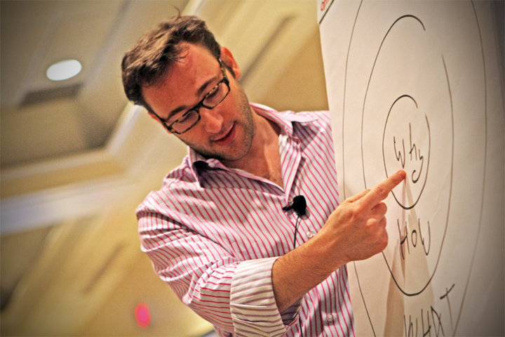
Step 1: start with why?
In his viral TED Talk, Simon Sinek says, “People don’t ‘buy’ what you do, they ‘buy’ why you do it.” All great and inspiring leaders and organizations in the world all think, act, and communicate the exact same way. Student organizations can learn a great deal from business strategy practices.

Slide 3
Step 1: start with why?
Watch Simon Sinek’s TED Talk
“How Great Leaders Inspire Action”
to discover The Golden Circle and start with why.
If video does not launch in slide, view it here: http://youtu.be/qp0HIF3SfI4

Slide 4
Step 2: write your why
After watching Simon Sinek’s TED Talk, it’s time to write your why!
Your organization’s Why Statement should follow the format below:
“To _____________, so that ________________.”
contribution impact

Slide 5
Why statement: cheese club
To explore the science, art, and beauty of cheese, so that the entire UIC community can understand it’s not just that cheese is great, it’s cheese that makes everything “grater.”

Slide 6
Step 3: s.m.a.r.t. goals
Now that you have written your why, you should begin to set S.M.A.R.T. Goals for your organization’s first year.
Watch Venture Guide: SMART Goals.
If video does not launch in slide view it here: http://youtu.be/3y0Jja52B2o

Slide 7
Step 3: set s.m.a.r.t. goals
SMART GOAL:
S – Specific
M – Measurable
A – Actionable
R – Realistic
T - Timely
Set 3 SMART Goals involving the following areas:
Member Recruitment
Events
Transition of Leadership

Slide 8
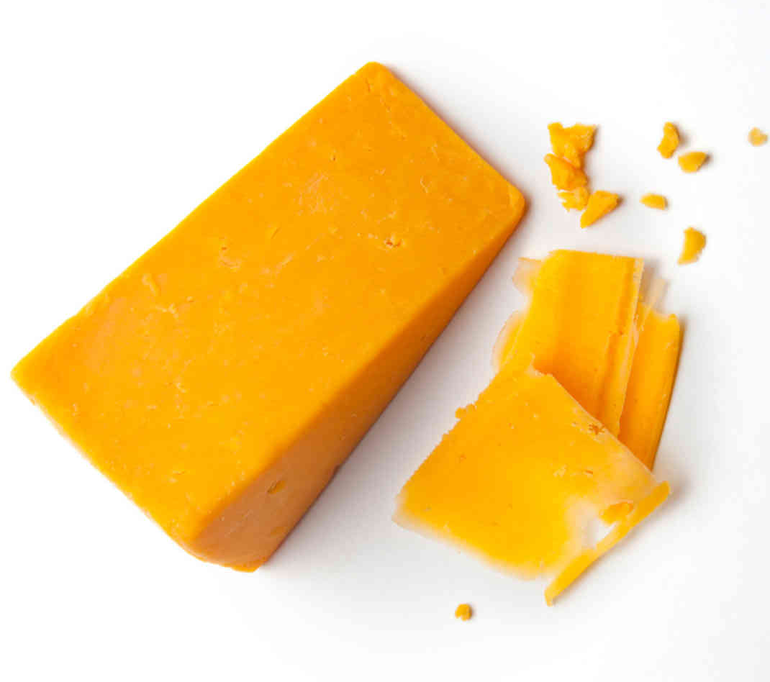
Smart goals: the cheese club
SMART Goals
1. The Cheese Club will recruit 10 more members by May 2022 through tabling at the New Student Organization Fair, sharing our Owl Connect Org Page on Facebook and Twitter, and asking each current member to bring 1 friend to our monthly meetings.
2. We will host 1 International Cheese Festival with samples, cooking demonstrations, and guest speakers by February 2016.
3. The Cheese Club will prepare a leadership transition binder filled with resources, future goals, status reports and other useful information to aid the new officers to take over after elections by January 1, 2016.
These are only examples.
Your SMART goals should be personalized
to fit your organization’s why!

Slide 9
STEP4: CREATE A FIRST YEAR PLAN
The last step to prepare for your New Organization Presentation is creating your first year plan. Your first year plan can be in any electronic format (PowerPoint, timeline, poster, etc.). It should trace your organization’s journey during the next year month-by-month and show when and how you’ll take action on your SMART Goals.

Slide 10
First year plan: the cheese club
June 2017
Complete Organization Officer and Advisor Compliance Training by June 1st
Apply for New Org Registration with Campus Programs by June 1^{5th}
July
Apply for Involvement Fair by July 15th
Apply for monthly meeting space with Meetings & Conferences by July 31st.
Advertise on UIC Connection
Research fundraising ideas for next year
August
Set staffing schedule for Involvement Fair table.
Design recruitment marketing materials.
Social Media Campaign-Ask members to Tweet about the Cheese they’ve been eating during summer. Did anyone travel internationally?
September
Host recruitment table at Involvement Fair.
Host first monthly meeting
Each current member should bring 1 friend with them
Icebreakers/Games to welcome members
Discuss community service options to outreach to local high schools about cheese education.
Brainstorming for International Cheese Festival
October
Contact guest speakers/chefs for International Cheese Festival
Monthly Meeting: Ice Breakers
November
Continue planning International Cheese Festival
Apply for Winter Involvement Fair
Monthly meeting: Topic: Fundraiser-Cheese Sale?
Place meeting space reservations for Spring 2016 with Meetings and Conferences
Share our Owl Connect Page on FB, Twitter during the break to keep members engaged
December
Plan Welcome Back Meeting
Plan staffing for table Winter Involvement Fair
Confirm guest speakers/chefs for International Cheese Festival
Share our Owl Connect Page on FB, Twitter during the break to keep members engaged
SMART Goals Refresher
January 2018
Host table at Winter Involvement Fair
Market International Cheese Festival
Monthly Meeting, Topic: Cheese making lessons
February
Monthly meeting : Member’s Choice!
Hold International Cheese Festival
Announce nominations for officer elections for 2016-17
March
Monthly Meeting: Topic TBD
Field trip to a Cheese Factory!
Hold officer elections for 2016-17
April
Monthly Meeting: These are a few of my favorite Bries!
Begin officer transitions
Renew registration for 2016-17 year
Place space reservations for Fall 2016 with Meetings and Conferences
Host an end of the year member social at a local cheese shop
May
Reflection on our first year, plans for the next year
Share our Owl Connect Page on FB, Twitter
June
Share our Owl Connect Page on FB, Twitter

Slide 11
The presentation
Once you have completed Steps 1 through 4, you and your founding members will be ready for your New Organization Request Presentation with Campus Programs!
The session will last 10 minutes. Prepare to present your Why Statement, SMART Goals, and First Year Plan in 7 minutes, leaving 3 minutes for questions. This session should be presented by at least 2 organization officers.
Bring your presentation on a flash drive.
FOR 2021-2022 Cycle New Student Organizations should prepare their First Year Plan and email to orgsupport@uic.edu 24 hours PRIOR to attending their registration lab.

Slide 12
Questions
Questions should be directed to
orgsupport@uic.edu
See you at your presentation!

